Slide 1
Chapter 4
Entity Relationship (ER) Modeling
Database Systems:
Design, Implementation, and Management, Sixth Edition, Rob and Coronel

Slide 2
In this chapter, you will learn:
How relationships between entities are defined and refined, and how such relationships are incorporated into the database design process
How ERD components affect database design and implementation
How to interpret the modeling symbols for the four most popular ER modeling tools
That real-world database design often requires that you reconcile conflicting goals

Slide 3
The Entity Relationship (ER) Model
ER model forms the basis of an ER diagram
ERD represents the conceptual database as viewed by end user
ERDs depict the ER model’s three main components:
  Entities
  Attributes
  Relationships

Slide 4
Entities
Refers to the entity set and not to a single entity occurrence
Corresponds to a table and not to a row in the relational environment
In both the Chen and Crow’s Foot models, an entity is represented by a rectangle containing the entity’s name
Entity name, a noun, is usually written in capital letters

Slide 5
Attributes
Characteristics of entities
In Chen model, attributes are represented by ovals and are connected to the entity rectangle with a line
Each oval contains the name of the attribute it represents
In the Crow’s Foot model, the attributes are simply written in the attribute box below the entity rectangle

Slide 6
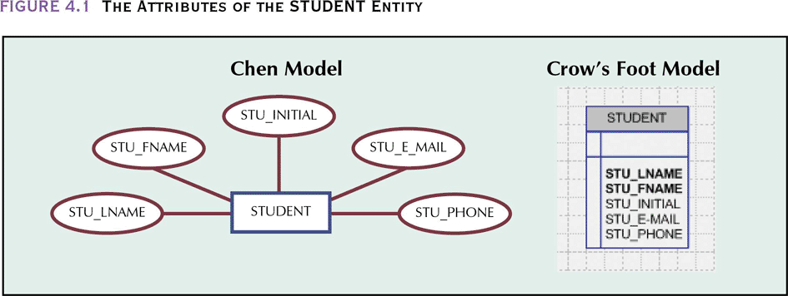
The Attributes of the STUDENT Entity

Slide 7
Domains
Attributes have a domain:
  The attribute’s set of possible values
Attributes may share a domain
  For example, the Address attribute for both Customer and Agent can have similar type entries

Slide 8
Primary Keys
Underlined in the ER diagram
Key attributes are also underlined in a frequently used table structure shorthand
  CAR(CAR_VIN,MOD_CODE, CAR_YEAR,CAR_COLOR)
Ideally composed of only a single attribute
Possible to use a composite key:
  Primary key composed of more than one attribute

Slide 9
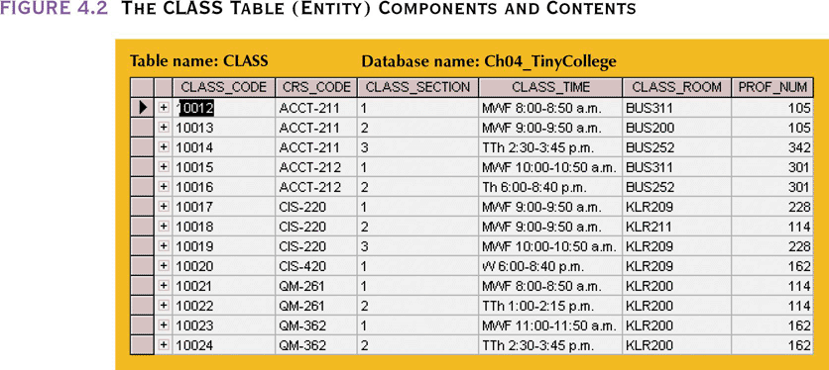
The CLASS Table (Entity)
Components and Contents
The table below can be represented as
  CLASS(CLASS_CODE,CRS_CODE, CLASS_SECTION, CLASS_TIME, CLASS_ROOM,PROF_NUM) or
  CLASS(CRS_CODE, CLASS_SECTION, CLASS_CODE,CLASS_TIME, CLASS_ROOM,PROF_NUM)

Slide 10
Attributes
Composite attribute
  Not to be confused with composite key.
  This is an attribute that can be broken down into more atomic attributes
    Address can be divided into street, city, state and zip
Simple attribute– no further division possible
Single-value attribute – can have only one value (social security number)
Multivalued attributes – a household may have several phone numbers
  Denoted with a double connecting line in the Chen model

Slide 11
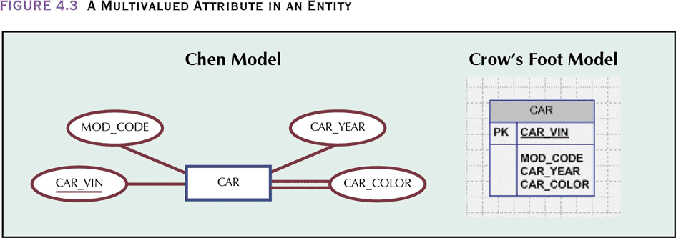
A Multivalued Attribute in an Entity

Slide 12
Resolving Multivalued Attribute Problems
Although the conceptual model can handle multivalued attributes, you should not implement them in the relational DBMS. Instead, follow one of these two options
  Within original entity, create several new attributes, one for each of the original multivalued attribute’s components
    CAR_COLOR can be split into CAR_TOPCOLOR, CAR_BODYCOLOR and CAR_TRIMCOLOR
    Can lead to major structural problems in the table.
      If some cars have many types of colors and others have few colors, then all cars need to have attributes to handle the maximum number of colors. But many of those fields will be null for many rows.

Slide 13
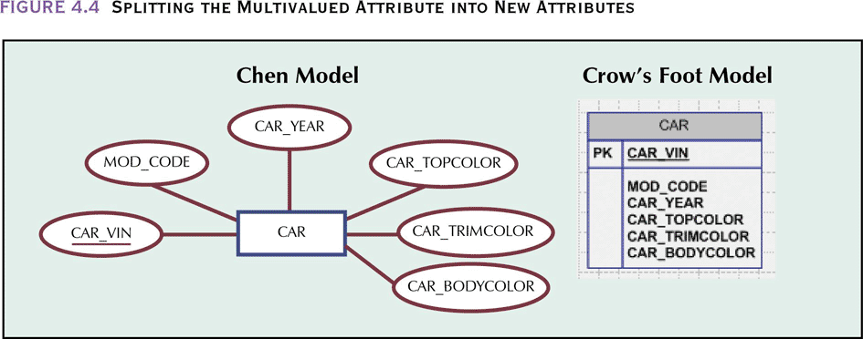
Splitting the Multivalued
Attribute into New Attributes

Slide 14
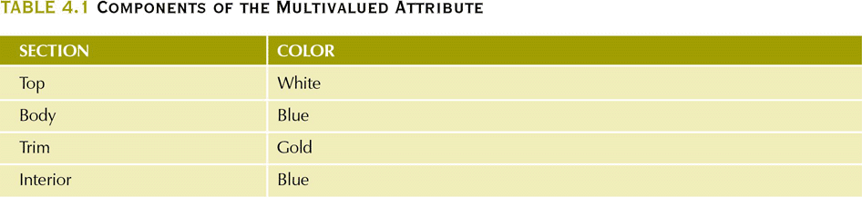
Components of the Multivalued Attribute

Slide 15
Resolving Multivalued Attribute Problems
  Create a new entity composed of the original multivalued attribute’s components.
    The new entity is related to the original entity in a 1:M relationship
    Color needs to be defined only for those sections that have color. This is done in the COL_SECTION attribute

Slide 16
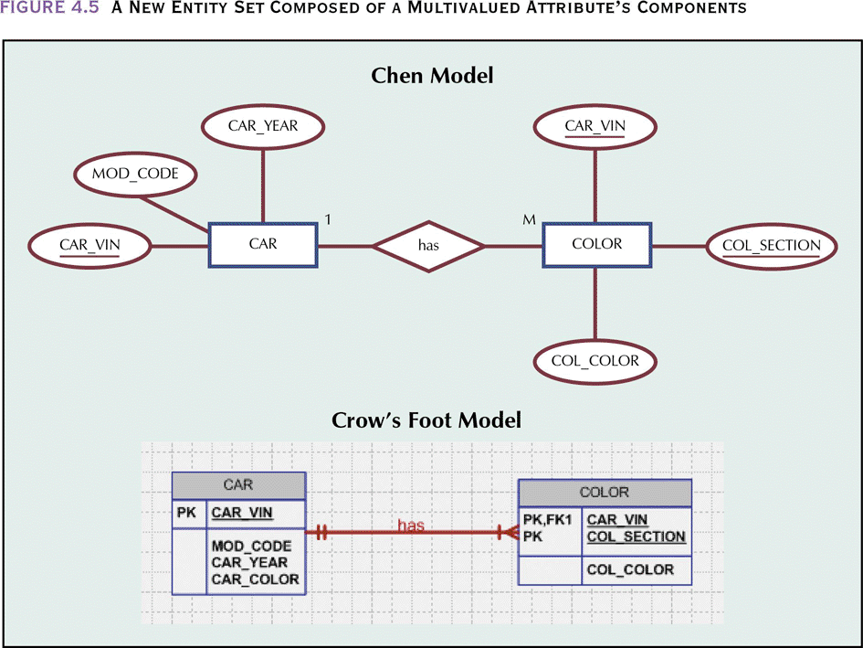
A New Entity Set Composed of a Multivalued Attribute’s Components

Slide 17
Derived Attributes
Attribute whose value may be calculated (derived) from other attributes
  Age can be calculated by subtracting date of birth from current date
Need not be physically stored within the database but can be based on processing requirements
Can be derived by using an algorithm
Denoted by a dashed line in the Chen model

Slide 18
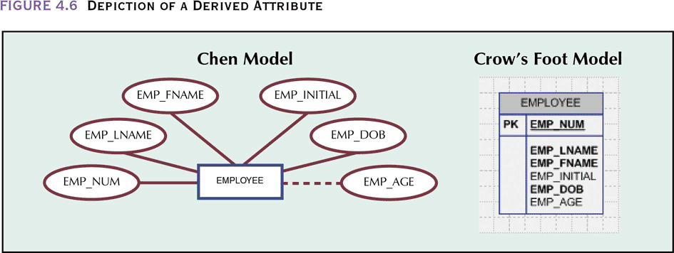
Depiction of a Derived Attribute

Slide 19
Relationships
Association between entities
Participants:
  Entities that participate in a relationship
Relationships between entities always operate in both directions
Relationship classification is difficult to establish if you only know one side
  A DIVISION is managed by one EMPLOYEE
    Don’t know if this is 1:1 or 1:M, must know if an EMPLOYEE can manage more than one DIVISION

Slide 20
Connectivity and Cardinality
Connectivity
  Used to describe the relationship classification
Cardinality
  Expresses the specific number of entity occurrences associated with one occurrence of the related entity
Established by very concise statements known as business rules

Slide 21
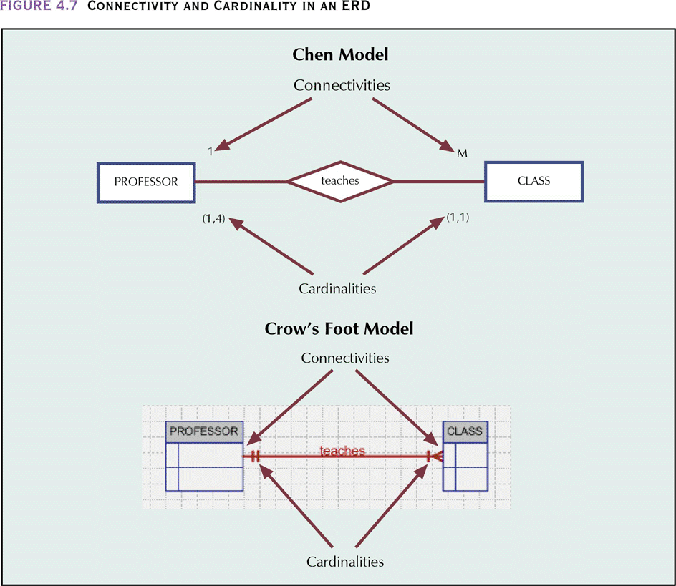
Connectivity and Cardinality in an ERD

Slide 22
RELATIONSHIP Strength
Existence dependence
  Entity’s existence depends on the existence of one or more other entities
    EMPLOYEE claims DEPENDENT
Existence independence
  Entity can exist apart from one or more related entities
    PART supplied by VENDOR (some parts may be in-house)

Slide 23
RELATIONSHIP Strength
Weak (non-identifying) relationships
  One entity is not existence-independent on another entity
    The PK of the related entity does not contain a PK component of the parent entity. The CLASS PK did not inherit the PK component from the COURSE entit
      COURSE(CRS_CODE, DEPT_CODE, CRS_DESC,CRS_CREDIT)
      CLASS(CLASS_CODE, CRS-CODE,CLASS_SECTION,…)

Slide 24
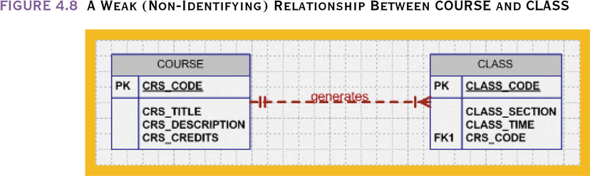
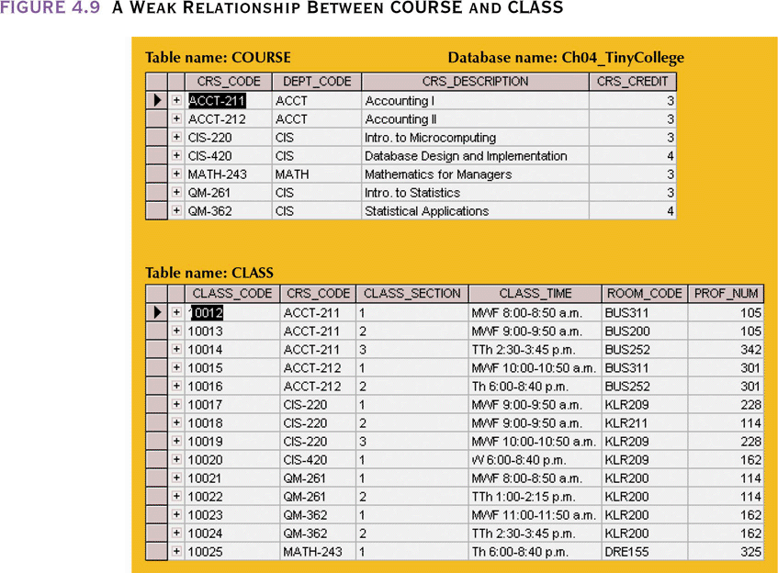
A Weak (Non-Identifying) Relationship Between COURSE and CLASS

Slide 25
RELATIONSHIP Strength
Strong (Identifying) Relationships
  Related entities are existence-dependent
  Whenever the PK of the related entity contains a PK component of the parent entity
      COURSE(CRS_CODE, DEPT_CODE, CRS_DESC,CRS_CREDIT)
      CLASS(CRS_CODE,CLASS_CODE, CRS-CODE, CLASS_SECTION,…)

Slide 26
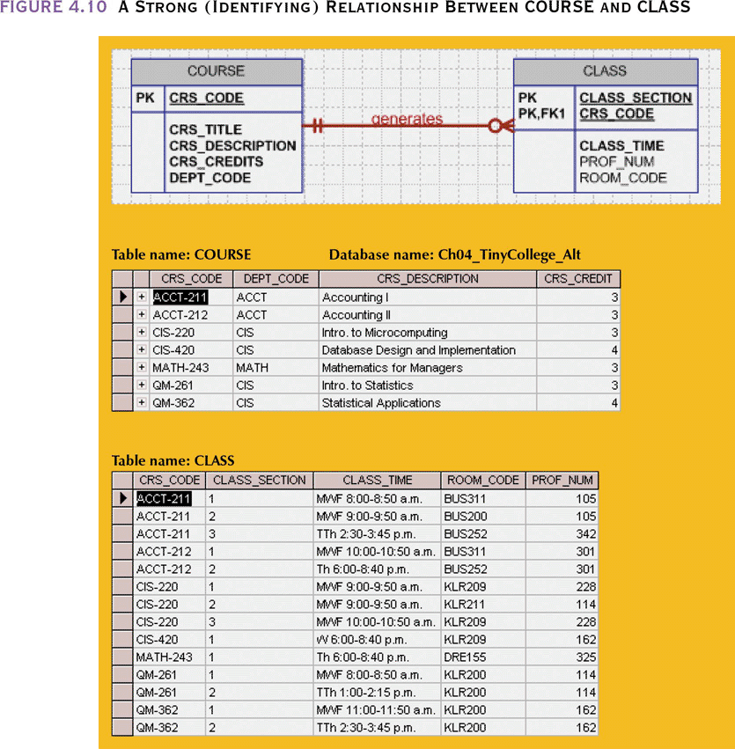
A Strong (Identifying) Relationship Between COURSE and CLASS

Slide 27
Relationship Participation
Optional:
  One entity occurrence does not require a corresponding entity occurrence in a particular relationship
    COURSE generates CLASS – some courses may not generate a class
    A small circle is drawn on the side of the optional entity in the Chen and Crow’s foot models)
Mandatory:
  One entity occurrence requires a corresponding entity occurrence in a particular relationship
    Minimum cardinality of 1

Slide 28
Relationship Participation and Strength
Incorrect to conclude that relationships are weak when they are created between optional entities and string between mandatory entities
You can have a strong relationship with optional relationship participation
  EMPLOYEE and DEPENDENT – strong relationship but an employee may have no dependents (more on this soon)

Slide 29
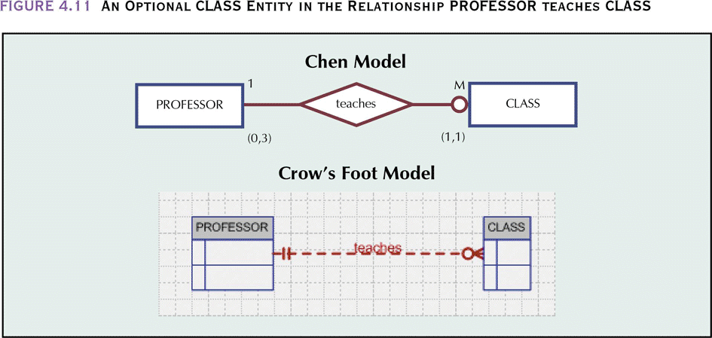
An Optional CLASS Entity in the Relationship PROFESSOR teaches CLASS
A PROFESSOR may not teach a CLASS – CLASS is optional to PROFESSOR
A CLASS must be taught by a PROFESSOR – PROFESSOR is mandatory to CLASS
  (0,3) means a PROFESSOR can teach no courses and up to a maximum of 3
  (1,1) means a CLASS has exactly one PROFESSOR

Slide 30
COURSE and CLASS
What does the relationship “COURSE generates CLASS” imply
  CLASS is optional – there may be courses with no classes (not offered each semester)
  CLASS is mandatory – each COURSE must have a least one COURSE
1 M
1 M
COURSE _{(0,N)}
generates
_{(1,1)} CLASS
Optional
Mandatory
COURSE _{(1,N)}
generates
_{(1,1)} CLASS

Slide 31
Relationship Strength and Weak Entities
Weak entity meets two conditions
  Existence-dependent:
    Cannot exist without entity with which it has a relationship
  Has primary key that is partially or totally derived from the parent entity in the relationship
  EMPLOYEE has DEPENDENT (see next slide)
  In the Chen mode, the weak entity has a double border
  In the Crow’s foot model, the PK/FK designation is used
Database designer usually determines whether an entity can be described as weak based on the business rules

Slide 32
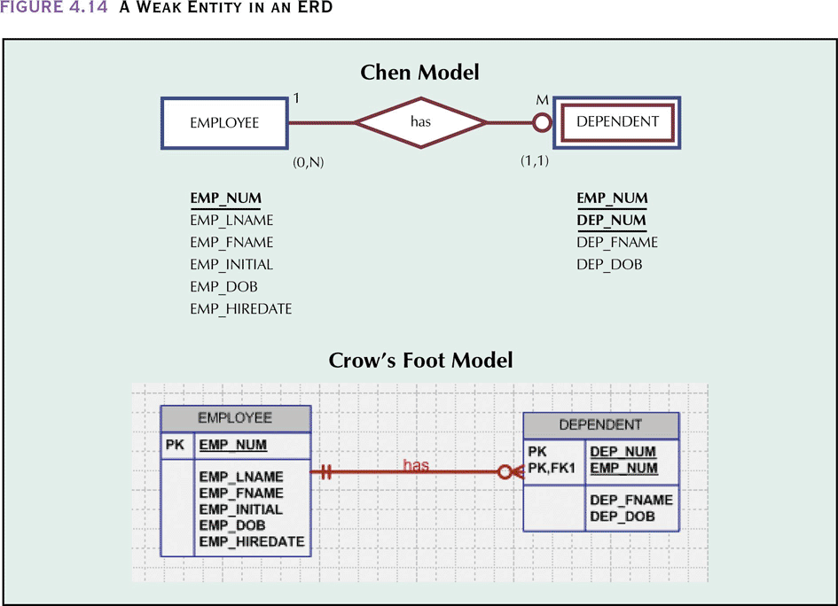
A Weak Entity in an ERD

Slide 33
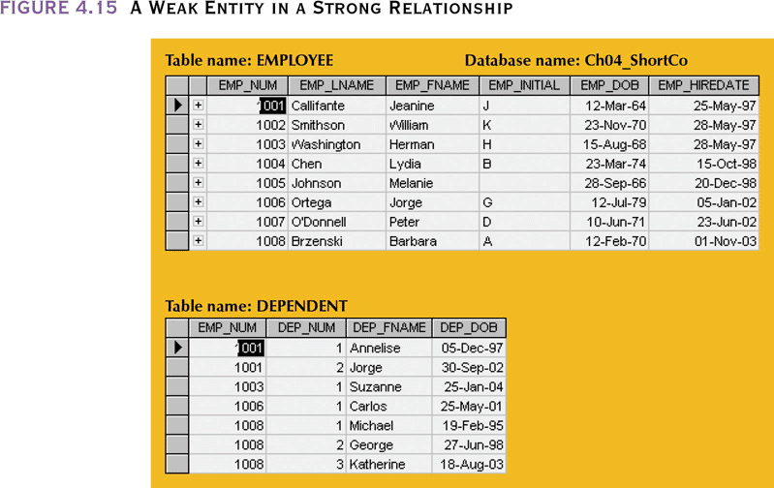
A Weak Entity in a Strong Relationship

Slide 34
Relationship Degree
Indicates number of associated entities or participants
Unary relationship
  Association is maintained within a single entity
Binary relationship
  Two entities are associated
Ternary relationship
  Three entities are associated
  Not necessarily equivalent to several 1:M relationships

Slide 35
Relationship Degree
Crow’s foot model does not allow implementation of M:N, additional entities are required
  Copy of the same entity in a unary relationship (COURSE)
  The CFR relationship in the Chen model is converted to an CFR entity in the Crow’s foot model

Slide 36
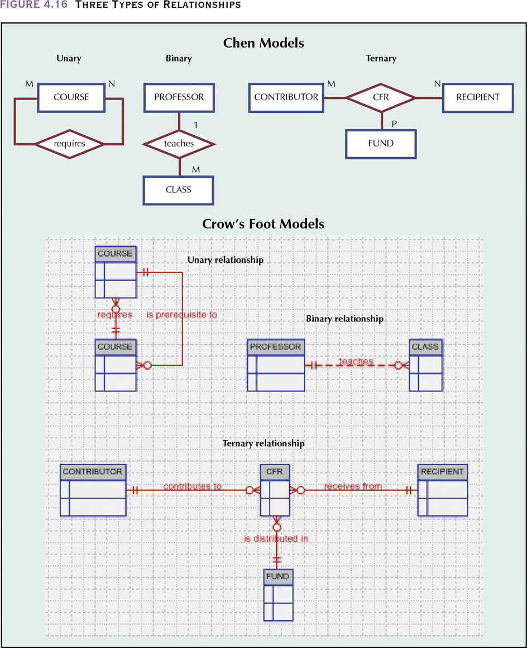
Three Types of Relationships

Slide 37
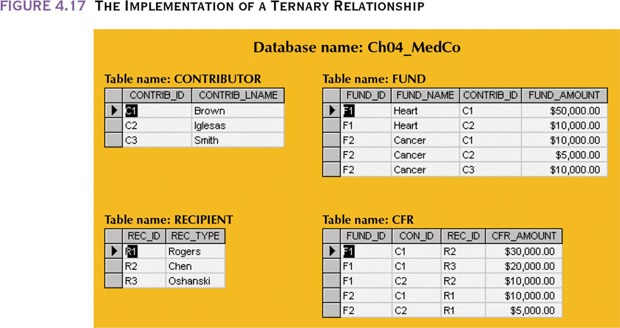
The Implementation of a
Ternary Relationship

Slide 38
Recursive Relationships
Relationship can exist between occurrences of the same entity set
Naturally found within a unary relationship
  1:1 -EMPLOYEE is married to one and only one other EMPLOYEE
  1:M - An EMPLOYEE may manage many EMPLOYEEs and each EMPLOYEE is managed by one EMPLOYEE
  M:N - A COURSE may be a prerequisite to many other COURSEs and each COURSE may have many other COURSEs as prerequisites

Slide 39
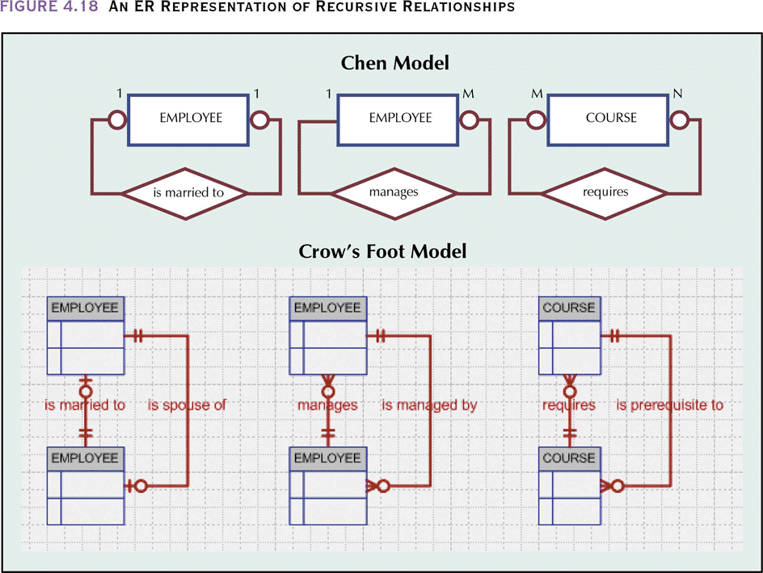
An ER Representation of Recursive Relationships

Slide 40
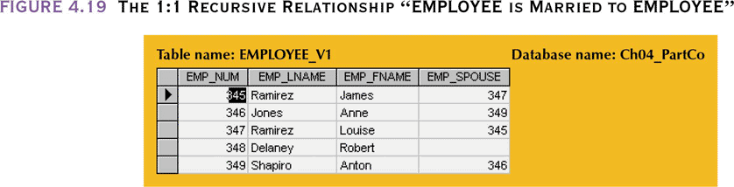
The 1:1 Recursive Relationship “EMPLOYEE is Married to EMPLOYEE”

Slide 41
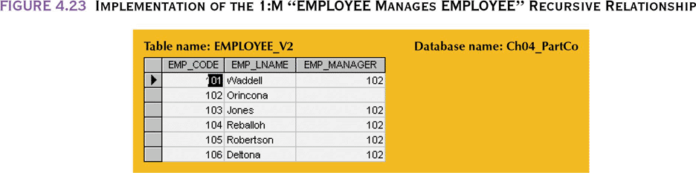
Implementation of the 1:M “EMPLOYEE Manages EMPLOYEE” Recursive Relationship

Slide 42
Implementation of the M:N Recursive “COURSE Requires COURSE” Relationship
COURSE
PREREQ
CRS_CODE | DEPT_CODE | CRS_DESCRIPTION | CRS_CREDIT
ACCT-211 | ACCT | Accounting I | 3
ACCT-212 | ACCT | Accounting II | 3
CIS-220 | CIS | Intro. to Microcomputing | 3
CIS-420 | CIS | Database Design and Implementation | 4
MATH-243 | MATH | Mathematics for Managers | 3
QM-261 | CIS | Intro. to Statistics | 3
QM-362 | CIS | Statistical Applications | 4
CRS_CODE | PRE_TAKE
CIS-420 | CIS-220
QM-261 | MATH-243
QM-362 | MATH-243
QM-362 | QM-261
MATH-243 is a prerequisite to QM-261 and QM-362
MATH-243 and QM-261 are prerequisites to QM-362

Slide 43
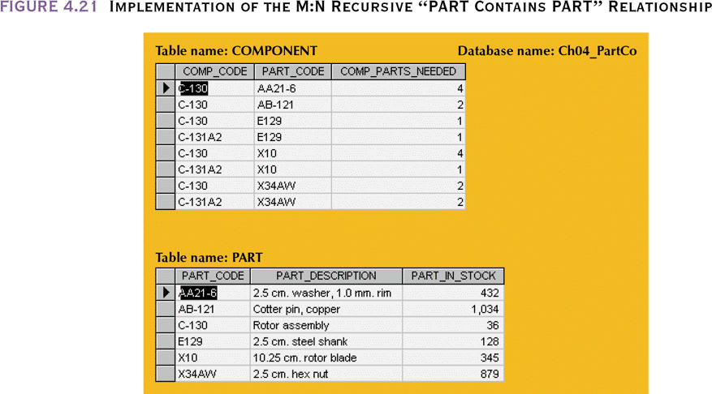
Implementation of the M:N Recursive “PART Contains PART” Relationship

Slide 44
Composite Entities
Also known as bridge entities
Composed of the primary keys of each of the entities to be connected
May also contain additional attributes that play no role in the connective process

Slide 45
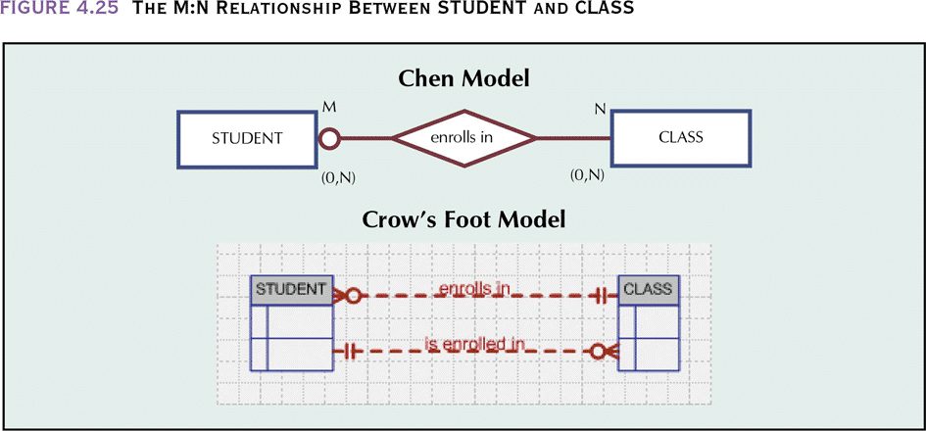
The M:N Relationship
Between STUDENT and CLASS
A class may exist even though it contains no students, thus the optional symbol appears on the STUDENT side of the M:N relationship

Slide 46
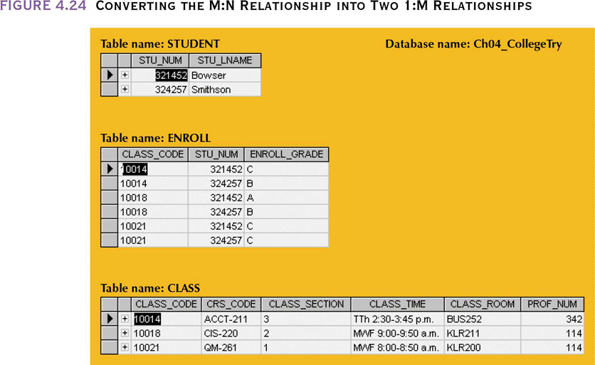
Converting the M:N Relationship into Two 1:M Relationships

Slide 47
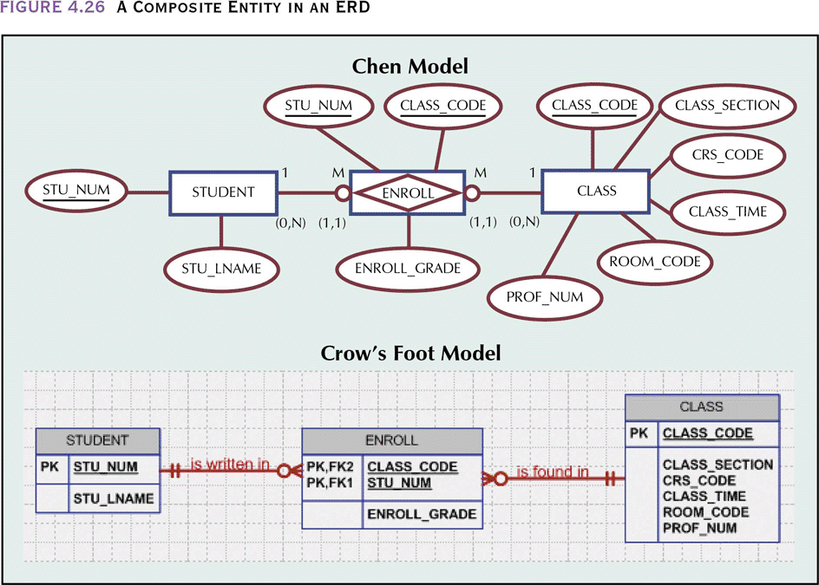
A Composite Entity in an ERD

Slide 48
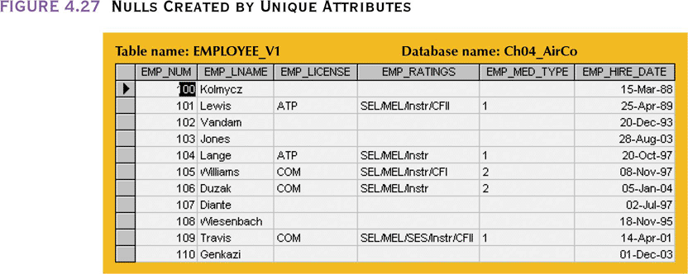
Nulls Created by Unique Attributes
Company has many types of employees, they have attributes in common and attributes unique to each type
  One table for all employees could have many nulls and/or dummy entries for the unique attributes not used by other types of employees

Slide 49
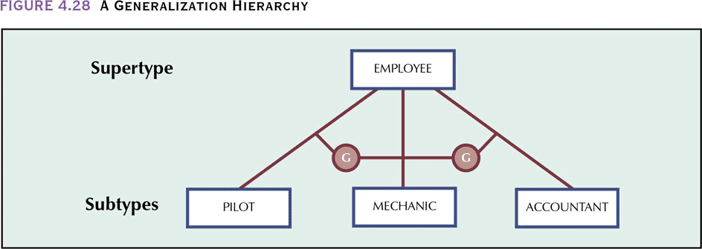
A Generalization Hierarchy
Depicts a relationship between a higher-level supertype entity and a lower-level subtype entity
  Supertype entity contains shared attributes
  Subtype entity contains unique attributes

Slide 50
Disjoint Subtypes
Also known as non-overlapping subtypes
  Subtypes that contain a subset of the supertype entity set
  Each entity instance (row) of the supertype can appear in only one of the disjoint subtypes
  Denoted by the symbol on the model
    Employee can be a pilot but not, at the same time, an accountant
Supertype and its subtype(s) maintain a 1:1 relationship
G

Slide 51
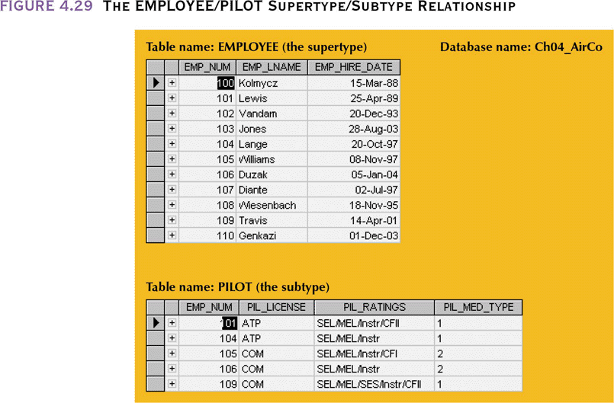
The EMPLOYEE/PILOT Supertype/Subtype Relationship

Slide 52
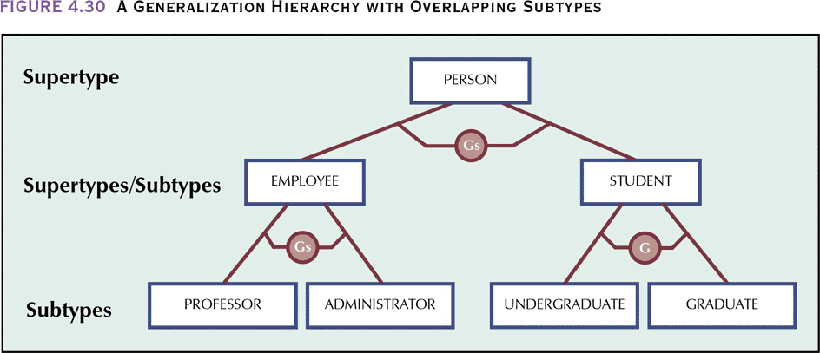
A Generalization Hierarchy with Overlapping Subtypes

Slide 53
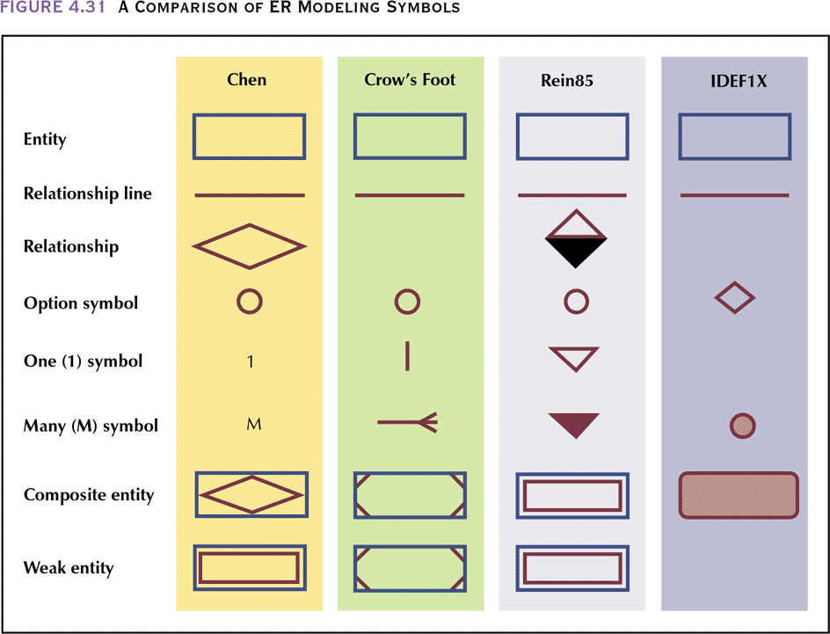
A Comparison of ER Modeling Symbols

Slide 54
A Comparison of ER Modeling Symbols
Chen model moved conceptual modeling into the practical database design arena by establishing basic building blocks: entities and relationships
  Dominant player in the CASE tool market during the 1980s and early 1990s
Crow’s Foot model combines connectivity and cardinality information in a single symbol set. Popularized by the Knowledgeware modeling tool
  Cardinality is limited to 0,1 or N

Slide 55
A Comparison of ER Modeling Symbols
Rein85 model based on the same modeling conventions as the Crow’s Foot model, it’s symbols are different.
  It does not recognize cardinalities explicitly, relying on connectivities to lead to logical cardinality conclusions
IDEF1X is a derivative of the integrated computer-aided manufacturing (ICAM) studies of the late 1970s.
  Became the source of graphical methods for defining the functions, data structures and dynamics of manufacturing businesses.
  The integration of these methods became know as IDEF(ICAM Definition). Hughes Aircraft developed the original version named IDEF1. The extended version, known as IDEF1X, became the USAF standard

Slide 56
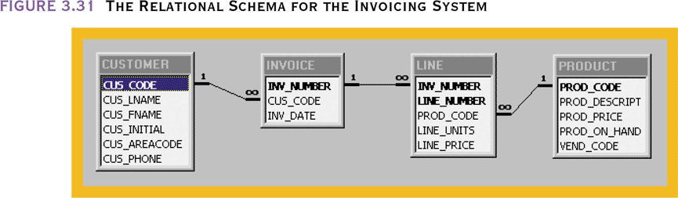
The Chen Representation of the Invoicing Problem
A customer may not have made a purchase so INVOICE is optional to CUSTOMER
Some products kept in inventory are never sold and may never show up in an invoice. INVOICE is optional to PRODUCT (M:N)
  Because LINE is used to decompose the M:N relationship into two 1:M realtionships, LINE becomes optional to PRODUCT

Slide 57
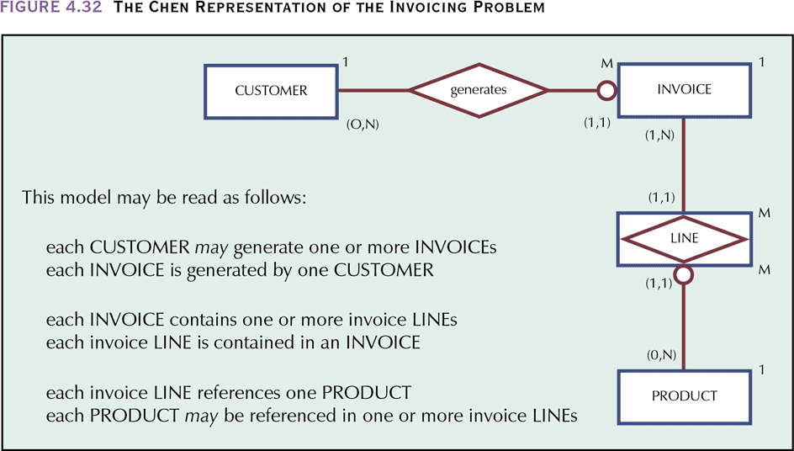
The Chen Representation of the Invoicing Problem

Slide 58
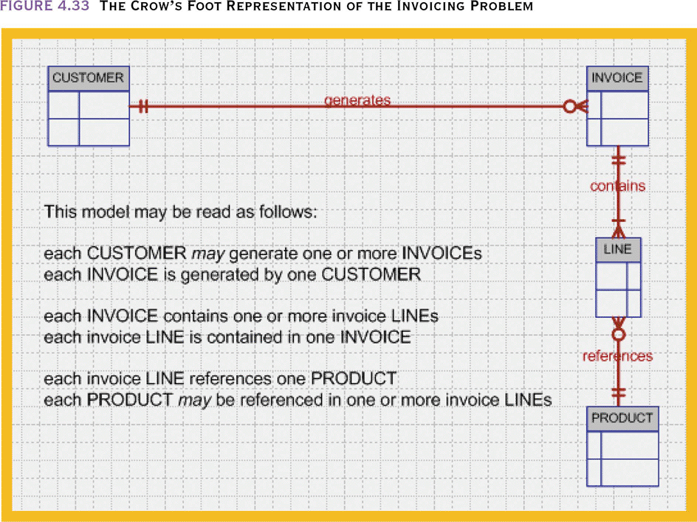
The Crow’s Foot Representation of the Invoicing Problem

Slide 59
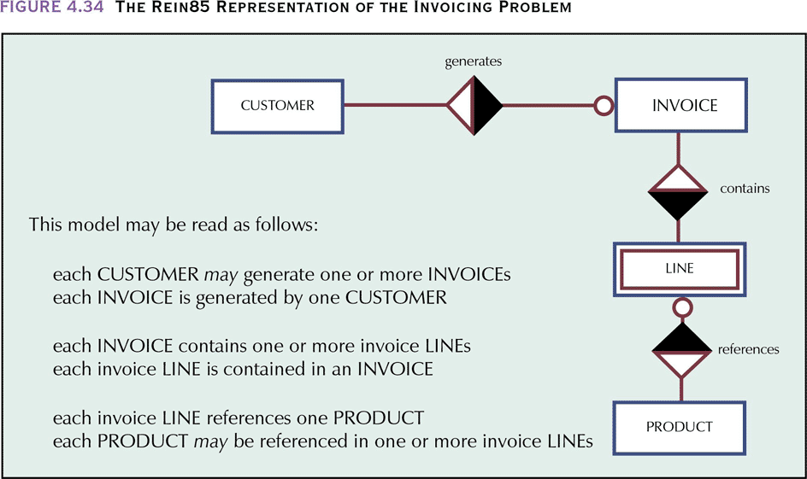
The Rein85 Representation of the Invoicing Problem

Slide 60
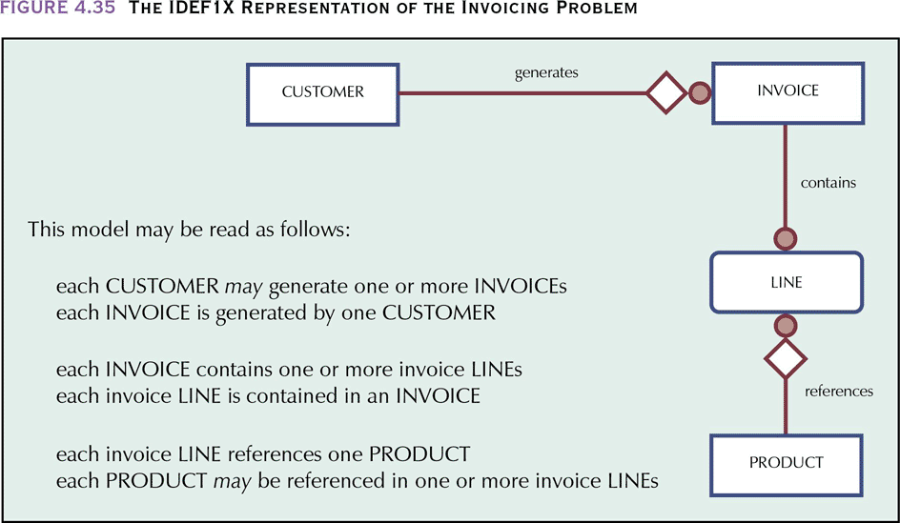
The IDEF1X Representation of the Invoicing Problem

Slide 61
Developing an ER Diagram
Database design is an iterative rather than a linear or sequential process
Information gathered from interviews but also by examining business forms and reports used on a daily basis
Iterative process
  Based on repetition of processes and procedures

Slide 62
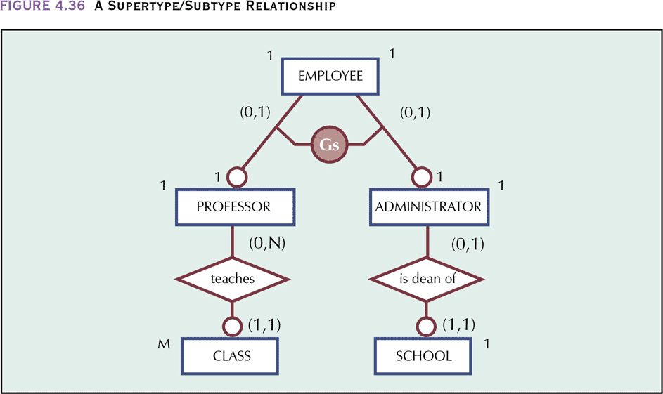
A Supertype/Subtype Relationship

Slide 63
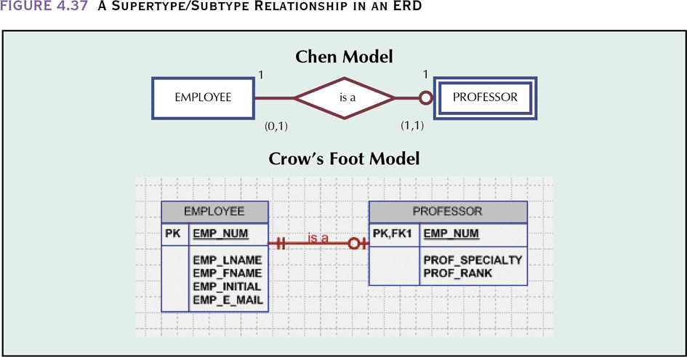
A Supertype/Subtype
Relationship in an ERD

Slide 64
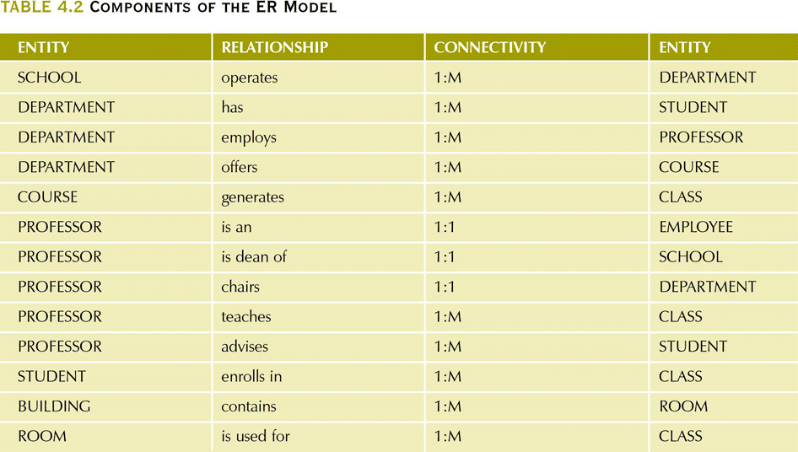
Components of the ER Model

Slide 65
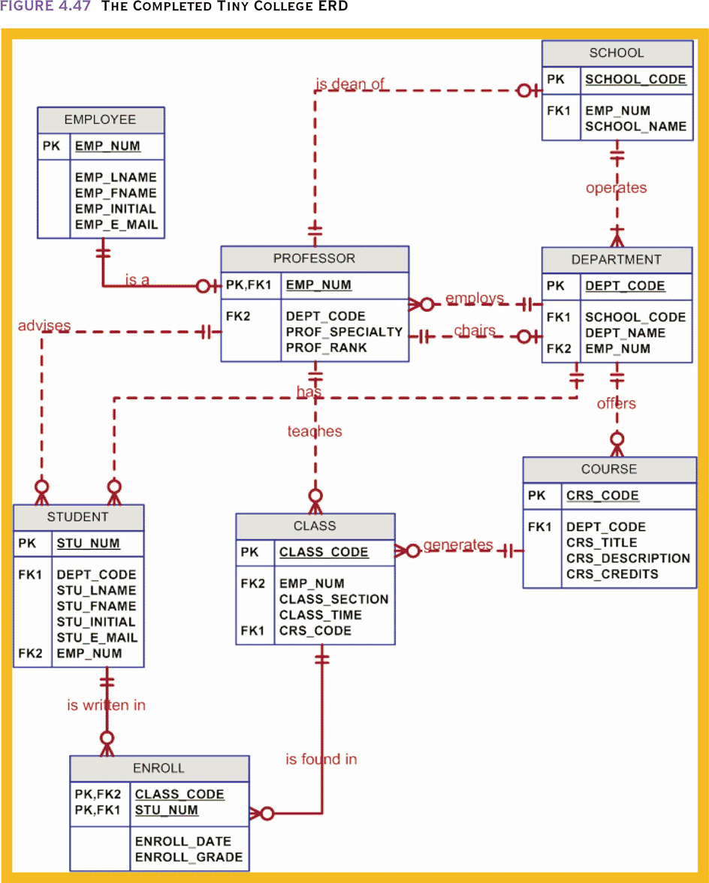
The Completed Tiny College ERD

Slide 66
The Challenge of Database Design: Conflicting Goals
Database design must conform to design standards
High processing speeds are often a top priority in database design
Quest for timely information might be the focus of database design
  Sacrificing some of the “clean” design structures and/or high transaction speed may necessary to ensure maximum information generation
    Instead of generating taxes, subtotals, totals, etc. each time a report is printed, compute and store these derived values
Other issues to consider– security, data integrity, performance, shared access

Slide 67
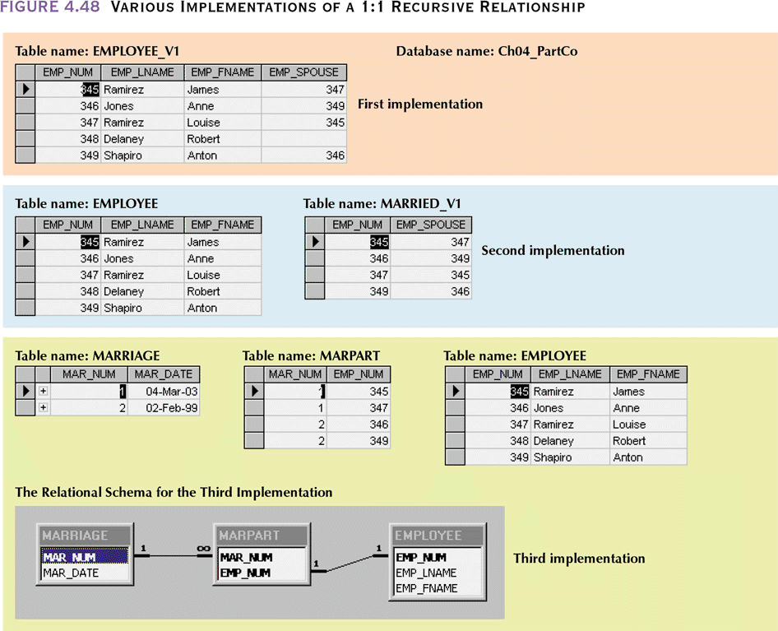
Various Implementations of a 1:1 Recursive Relationship

Slide 68
Various Implementations of a 1:1 Recursive Relationship
EMPLOYEE_V1 may cause anomalies
  If employees divorce, two records must be updated
  Those not married to other employees have a null entry
  Uses synonyms to refer to an employee – EMP_NUM and EMP_SPOUSE
MARRIED_V1
  Eliminates nulls but duplicate values are still possible (345,347) and (347,345) – each is unique
  Uses synonyms to refer to an employee – EMP_NUM and EMP_SPOUSE
Three table solution
  Add MARRIAGE and MARPART tables in a 1:M relationship
    Make EMP_NUM unique in MARPART so that an employee does not appear twice as married

